Slide 1
Boot Camp Project
Predicting Team Success in Europe’s Top 5 Leagues
Predicting Professional Soccer Team Success
By Elias Lopez, Chris Padilla, and David Chase

Slide 2

Questions to be Explored
Does the old catchphrase “Defense wins championships” apply to soccer?
Which categories are statistically significant to predict team’s success?
Based on our dataset, could we determine the qualifying teams in the following Champion League?

Slide 3





Reason
We choose to analyze the 5 largest European Leagues in soccer. (La Liga, Premier League, Serie A, Bundesliga, Ligue 1)
Our interest in sports drew our group together to develop an analysis based on previous team’s performance and mock up a statistical prediction for our project.
Our objective is to determine the metrics that accurately predict which teams will qualify for the following Champion League tournament.
Maybe we can win some money off it it?

Slide 4
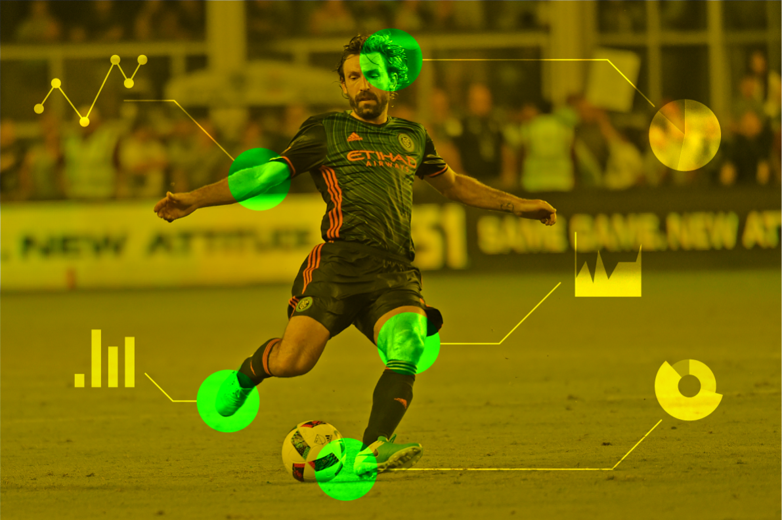
Exploration of the data
Granular player performance data was difficult to obtain. The best source of player data was from paid scouting services, and what was freely available was either not abundant or not very robust (especially for amateur sports.)
The best dataset we found was from footystats.org, which provides data for gambling purposes. They had data on most of the professional leagues in the world and in most cases their datasets went back 20 years.
The data was mostly team oriented and related to counting statistics kept during games. As a result we decided to focus on predicting team performance for the Top 5 Leagues.
Notes:
We were torn on whether to study basketball or soccer. We also discussed whether to focus on individual player evaluation or team performance.
If you would like please give us a few thousand dollars and we’d be happy to give you that analysis.

Slide 5
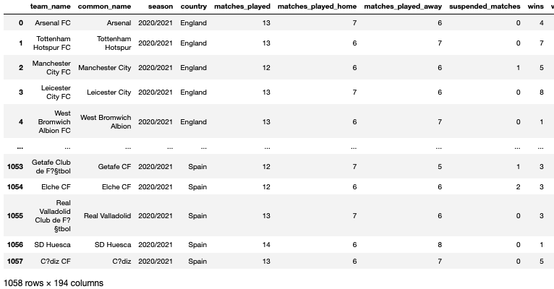
Data Description
FootyStats is the premier football stats and analysis site, with data coverage in 700+ football leagues worldwide including UK, Europe, and South America.
Stats include: Team stats, League stats, and Player stats are covered with details on form, goals scored, conceded, shots, xG (Expected Goals), corner stats, etc.
Source: footystats.org
Notes:
We looked at the teams in the top 5 domestic leagues over the last 10 years which originally contained 1,058 rows and 293 columns to help us analyze the different factors that go into winning.

Slide 6

Machine Learning Analysis
Preprocessing:
The target set was whether a team would qualify for the Champions League tournament, which they could do by finishing in the top 4 of their domestic leagues.
The feature set was all other factors in the model which were 195 other possible data points.
The data was split into past years (2010-2011 season to 2019-2020 season) and current season (2020-2021 season).
Notes:
We determined this by setting the “league position” column <=4. Lucky for us, we had great data to easily see this.
We ran a multi-regression model in R and feature importance in machine learning to determine the most important factors.

Slide 7
Machine Learning Analysis
The Balanced Random Forest Classifier was chosen and has an accuracy score of 81.2%.
This model also helped us by ranking the importance of input variables in a natural way.
Field | Feature Importance
Total Goals per Match | 14.80%
Total Wins at Home | 12.30%
First Team to Score Percentage | 12.10%
Percentage of Games Leading at Halftime | 8.70%
Failed to Score Percentage (Total) | 7.70%
Total Wins Away | 7.00%
Losing at Halftime Percentage | 6.20%
Goals Conceded per Match | 5.20%
Failed to Score at Halftime Percentage | 4.10%
Total Clean Sheet Percentage | 3.20%
 | Pre | Rec | F1
Champion | 0.70 | 0.70 | 0.92
Non-Champion | 0.92 | 0.92 | 0.70
Notes:
The random forest algorithm will sample the data and build several smaller, simpler decision trees. While simple decision trees are weak learners this was a good model because it is robust against overfitting as all of those weak learners are trained on different pieces of the data and runs efficiently on large datasets.
This model showed to have a precision as 70% for Champion teams and 92% for non-Champion teams.
So we can see that points per game, first team to score percentage, and goal differences were among the inputs with the highest percentage that influenced the machine learning model.

Slide 8
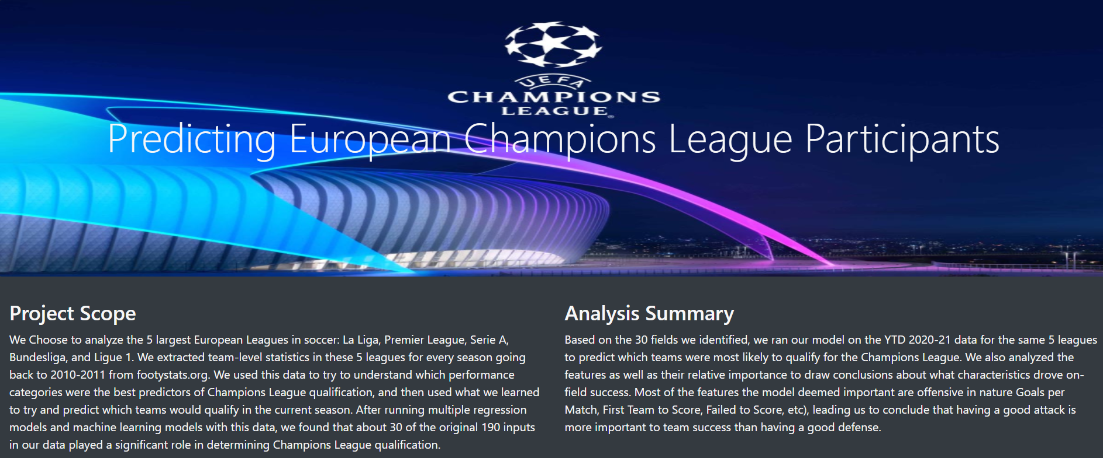
Dashboard
Page Header - “Predicting Soccer Team Success”
Description of the Project - This paragraph would describe the project and purpose of the project
Summary of the Analysis - This would provide summary of the data analysis and reference our findings below. The number of Data Visuals would be determined by the data analysis. For this storyboard we just are keeping it at 2
Filter 1:: Drop down with country for current year 2020-2021 season. Would show current league table in descending order by win prob%
Bar Graph just showing the % win by team
2nd Filter: Drop down with teams from the selected country which would show the relevant statistics

Slide 9
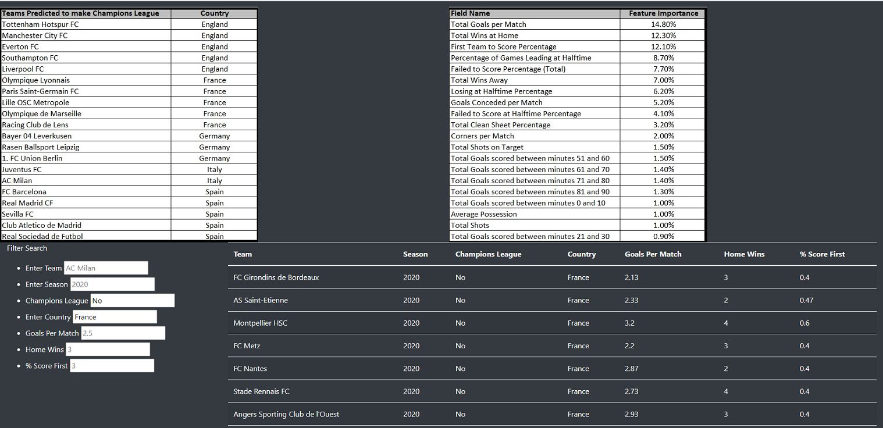

Dashboard - Tools Used
Some Soccer Picture
Table: showing teams ranked by potential win % and other important factors.
3rd Filter: Drop down of different factors
(4th filter: possible filter by country )l
This would show a number of expected win percentage for champion based on selected factors.
This would self populate based on filters and show the definition of the selected factors and why that would be important in the context of winning in soccer.
Notes:
We created a dashbaord to show our findings. We used JavaScript and SQL to organize and present the data to the user in a useful format.
Our project did not require us to scrape data from any website

Slide 10

Results:
Most of the features with high rates of importance were offensive categories, which suggests having a good attack is a better predictor of success than a good defense.
Scoring goals had an outsized effect on the outcomes of games. Scoring first was an important feature of good teams. Also, scoring late goals (which often lead directly to points) also proved to be a good predictor of team success.
We concluded that given the low scoring nature and the fine margins of soccer games, our findings made sense.
Your winners....

Slide 11
Team | League | Team | League
Tottenham Hotspur | Premier League | Bayer 04 Leverkusen | Bundesliga
Manchester City | Premier League | Rasenballsport Leipzig | Bundesliga
Everton | Premier League | 1. FC Union Berlin | Bundesliga
Southampton | Premier League | Juventus | Serie A
Liverpool | Premier League | AC Milan | Serie A
Olympique Lyonnais | Ligue 1 | FC Barcelona | La Liga
Paris Saint-Germain | Ligue 1 | Real Madrid | La Liga
Lille OSC Metropole | Ligue 1 | Sevilla | La Liga
Olympique de Marseille | Ligue 1 | Atletico Madrid | La Liga
Racing Club de Lens | Ligue 1 | Real Sociedad | La Liga
Notes:
Teams that will qualify the following Champions League

Slide 12

Recommendations
Design/Process Adjustments:
Incorporate live data into our storyboard.
Allow users to select more than one team and attempt to make a prediction of their own
Expand our data to include leagues from different countries
Create a prediction for the World Cup and other large tournaments around the world
Implementing players statistics
Additional Topics to Explore:
Do the categories which are most predictive change over time?
Do the categories vary by league?

Slide 13
Thank you!!

